Slide 1
History Review
Preview to Responsible Government

Slide 2
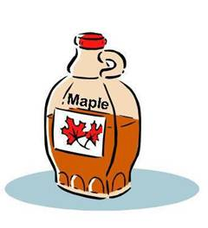
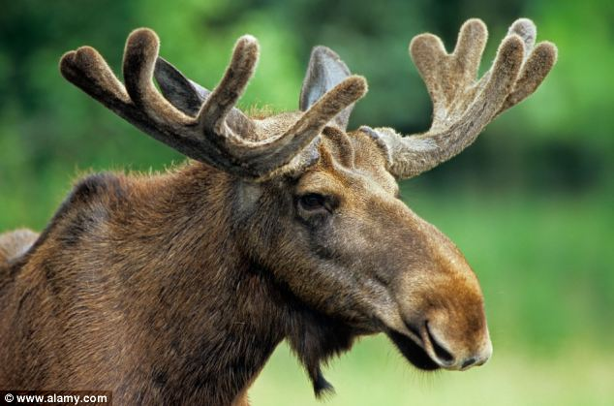
What is Canada Famous For?
Beaver
Polar Bear
Moose
Hockey
Maple Syrup
Tater Tots
I am Canadian
Tom Brokaw Explains Canada
Michael Moore, USA & Canada

Slide 3
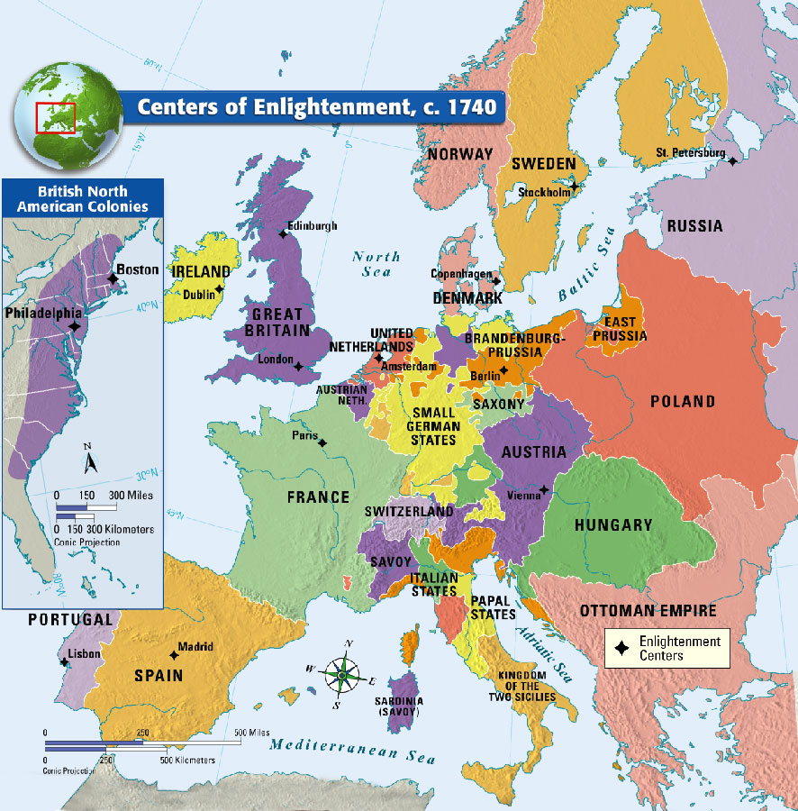
Top 3 European Powers
Great Britain
France
Spain

Slide 4
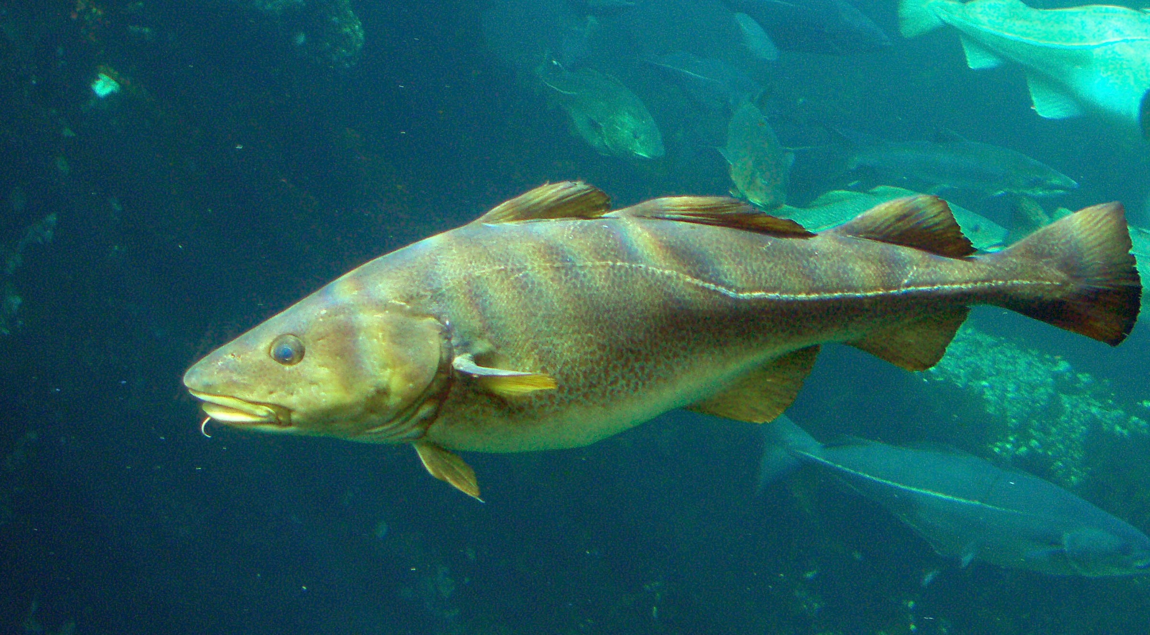
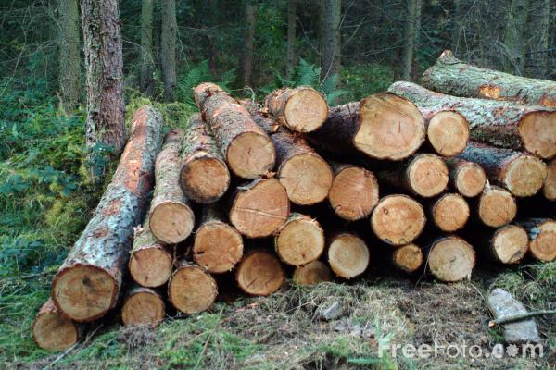
Why Were They Fighting?
Cod Fishing Grounds and Timber – Newfoundland and Acadia (Oak trees for boat building)
Fur Trade – St. Lawrence River
Native Fur Trade - Ohio River Valley

Slide 5
Industrial Revolution Effect
First reason explorers came was to find a route to Asia, but North America got in the way
Reason they came back was for rich, valuable resources
Fish, Timber, Fur
Increase in population led to increase demand for food
Demand for lumber to build homes and wooden ships
Improvements in medical and food production increased life expectancy
Need more raw materials due to increased population

Slide 6
1st Battle for Control of North America
7 Years War, beginning in 1756
French were outnumbered and poorly supplied in North America
British won the famous Battle of the Plains of Abraham and captured Quebec City Plains of Abraham
In 1763, the Treaty of Paris ended the 7 Years War and New France officially became British possession

Slide 7
French English Differences
English
French
Protestant Religion
Martin Luther protested against the way religion was run
Don’t need to confess to 3rd party
Felt Catholic Church abused power and strayed from teachings
English language
Civil laws and culture
Catholic Religion
Accepts the Pope as mediator between God and mankind
Purgatory belief
Priests can’t marry
Confess to a priest
French language
Civil laws and culture

Slide 8
Passionate French English Differences
Who’s your team?

Slide 9
War is Hard, Peace is Harder
What to do with French-speaking Catholics?
1. Kill them
2. Deport them
3. Assimilate them
Ignore them

Slide 10
Proclamation Act of 1763
To ensure that British institutions, laws, customs, language and religion were enforced in Quebec
To attract British settlers to Quebec
To limit the size of Quebec, cutting the Montreal fur traders out of the western fur trade
To reassure the Native peoples that their interests in the fur trade and their hunting grounds in Ohio Valley would be protected.
Proclamation Act (1:25.19)
Royal Proclamation explained
Proclamation Line

Slide 12
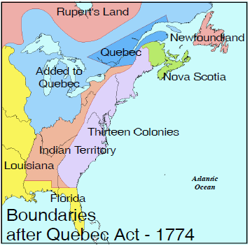
Quebec Act, 1774
Aim to combine the French and British ways of doing things, while maintaining French character of the colony
The Quebec Act (1:38.24)

Slide 13
Quebec Act Government Structure

